Slide 1
Proto C Parser by Daipayan Bhowal

Slide 2
Designing expression parser
Recursive descent parser are sets of recursion which will decide the combination of tokens
We are going to design a Recursive descent parser for C in which we are going to do in-lining, left recursion removal, left factoring, merging, commonality, cyclic reference removal, symbol matching first, lookahead based termination etc.
We will start from top to bottom grammer i.e. from expression/assignment-expression and move to bottom nodes like unary_expression, primary_expression & postfix_expression
The bottom nodes/leafs of the tree can only be one of them, either unary_expression or primary_expression or postfix_expression, all other symbols will be an operator
We will start the parsing from the top most nodes that can be assignment operator’s like ‘=’ ,’+=’ ‘-=’ etc. Or a comma operator ‘,’ for supporting list of multiple expressions as given in grammer

Slide 3
Designing expression parser
Suppose from this a expression grammer, how should be the pseudo-code for this ?
expression:
assignment-expression , expression
The Pseudo-code for the above grammer is:-
expression()
{
assignment-expression();
if(currentToken() == ‘,’)
expression();
}
As you can see from comma(‘,’) onwards it’s optional hence kept inside the if condition
expression:
assignment-expression {, expression}opt

Slide 4
Designing expression parser- inlining
assignment-expression:
conditional-expression
unary-expression assignment-operator assignment-expression
assignment-operator: one of
= *= /= %= += -= <<= >>= &= ^= |=
now replace the assignment-operator with each of the operators, The inlining for the above grammer is:-
assignment-expression:
conditional-expression
unary-expression = assignment-expression
unary-expression *= assignment-expression
unary-expression /= assignment-expression
unary-expression %= assignment-expression
unary-expression += assignment-expression
unary-expression -= assignment-expression
unary-expression <<= assignment-expression
unary-expression >>= assignment-expression
unary-expression &= assignment-expression
unary-expression ^= assignment-expression
unary-expression |= assignment-expression

Slide 5
Designing expression parser- commonality
now there is a problem with the assignment expression that it has chances to goto infinite loop or exceptional cases and it is heavy-computational
as it branches to 2 bottom node either to conditional-expression or unary-expression, hence in future shift-reduce conflict may occur due to this
Now, we need to reduce it to single bottom node which will make it more simple and more optimized so we replace unary-expression with conditional-expression
unary-expression also supports only subset of the language whereas conditional-expression supports more wider grammer
assignment-expression:
conditional-expression
conditional-expression = assignment-expression
conditional-expression *= assignment-expression
conditional-expression /= assignment-expression
conditional-expression %= assignment-expression
conditional-expression += assignment-expression
conditional-expression -= assignment-expression
conditional-expression <<= assignment-expression
conditional-expression >>= assignment-expression
conditional-expression &= assignment-expression
conditional-expression ^= assignment-expression
conditional-expression |= assignment-expression
Now we can theoretically rewrite to reduce it to single line
assignment-expression:
conditional-expression { {any one of ‘=’, ‘*=’, ‘/=’, ‘%=’, ‘+=’, ‘-=’, ‘<<=’, ‘>>=’, ‘&=’, ‘^=’, ‘|=’ } assignment-expression }opt
This rule is used in entire grammer repeatedly for other expressions

Slide 6
Expression parsing -left recursion removal
This is the original grammar given in K&R book for logical OR
logical-OR-expression:
logical-AND-expression
logical-OR-expression || logical-AND-expression
Issue here can be clearly seen is that this grammar will goto infinite loop when implemented as logical-OR-expression will call itself logical-OR-expression in the first line of code so it will go into infinite loop
logical-OR-expression || logical-AND-expression , now we will swap/change it to logical-AND-expression || logical-OR-expression
now logical-AND-expression becomes the common bottom next node and logical-OR-expression will call itself when it will encounter ‘||’ string or else it will terminate, so termination condition will occur for this recursion but still code will execute the bottom node logical-AND-expression.
There is another reason why logical-OR-expression called as a tail-recursion instead of logical-AND-expression because if multiple sequential ‘||’ operator comes in an expression then it will fail in that scenario i.e. l = x || y || z || f; , only one ‘||’ operator can be handled so x || y will be procesed rest part || z || f; will halt the parser
the same above logic will be applied for all the nodes i.e, inclusive-OR-expression, relational-expression etc..
Psuedo-code for logical-OR-expression
logical-OR-expression() // without left recursion
{
logical-AND-expression();
if(currentToken() == ‘||’)
logical-OR-expression();
}

Slide 7
Designing expression parser- left recursion removal
the same above logic will be applied to complex cases
relational-expression:
shift-expression
relational-expression < shift-expression
relational-expression > shift-expression
relational-expression <= shift-expression
relational-expression >= shift-expression
now modified grammer will be:-
relational-expression:
shift-expression
shift-expression < relational-expression
shift-expression > relational-expression
shift-expression <= relational-expression
shift-expression >= relational-expression
pseudo-code will be as below:-
relational-expression()
{
shift-expression();
if(currentToken() == ‘>’ ||
currentToken() == ‘<’ ||
currentToken() == ‘<=’ ||
currentToken() == ‘>=’)
relational-expression();
}

Slide 8
Designing expression parser- merging/cyclic reference
For the given below grammar we can observe that cast-expression is common among these grammar,
the problem is that unary-expression calls cast-expression and cast-expression calls unary-expression due to which there will be an cycle,
this cycle can cause infinite loop, for solving this problem we will do merging of unary-expression & cast-expression into unary-expression, and remove cast-expression, wherever we are calling cast-expression now we will call unary-expression after merging
Note: Before merging we need to do inlining & remove left recursion first
unary-expression:
postfix-expression
++ unary-expression
-- unary-expression
unary-operator cast-expression
sizeof unary-expression
sizeof ( type-name )
unary-operator: one of
& * + - ~ !
cast-expression:
unary-expression
( type-name ) cast-expression
multiplicative-expression:
cast-expression
multiplicative-expression * cast-expression
multiplicative-expression / cast-expression
multiplicative-expression % cast-expression

Slide 9
Designing expression parser- merging/cyclic reference
First apply inling , then remove the left recursion
and finally merge the grammar
This is the merged unary-expression
unary-expression:
postfix-expression
++ unary-expression
-- unary-expression
unary-operator unary-expression
( type-name ) unary-expression // cast-expression merged into unary-expression due to cyclic reference
sizeof unary-expression
sizeof ( type-name )
multiplicative-expression:
unary-expression
unary-expression * multiplicative-expression
unary-expression / multiplicative-expression
unary-expression % multiplicative-expression

Slide 10
Designing expression parser- left factoring
We need to modify some of the grammar in which left recursion is present but which also expands on the left side, this case left recursion cannot be removed directly as terminals symbols(‘[‘, ‘(‘, ‘.’, ‘->’, ‘++’ ‘--’) of the postfix expression can keep on coming as we lookahead
if we do left recursion removal by adding postfix-expression at end, then the entire grammar meaning will change
postfix-expression:
primary-expression
postfix-expression [ expression ]
postfix-expression ( argument-expression-list_opt )
postfix-expression . Identifier
postfix-expression -> identifier
postfix-expression ++
postfix-expression --
To solve this we will place primary-expression in place of postfix-expression and postfix-expression will be added at end with new name of postfix-expression-dash, postfix-expression-dash will be a new grammar node which will keep looping when terminal symbols(‘[‘, ‘(‘, ‘.’, ‘->’, ‘++’ ‘--’) will occur and the grammar will keeo expand right side, not left side , so new grammar will look like this
postfix_expression
: primary_expression
| primary_expression '[' expression ']' postfix_expression_dash
| primary_expression (' argument_expression_list ')' postfix_expression_dash
| primary_expression '.' IDENTIFIER postfix_expression_dash
| primary_expression '->' IDENTIFIER postfix_expression_dash
| primary_expression ++ postfix_expression_dash
| primary_expression -- postfix_expression_dash

Slide 11
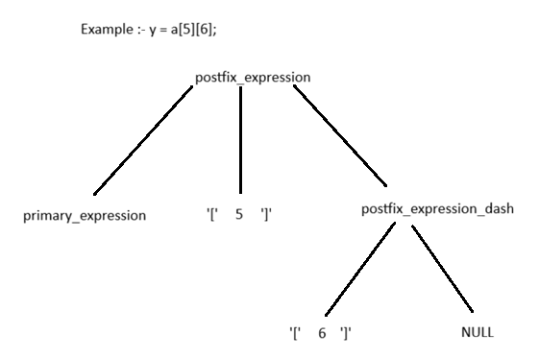
Designing expression parser- left factoring
postfix_expression_dash is designed as such if it gets terminal symbols(‘[‘, ‘(‘, ‘.’, ‘->’, ‘++’ ‘—’) then it will again call itself or else it will terminate and goback to postfix_expression
postfix_expression_dash:
'[' expression ']' postfix_expression_dash
| '(' argument_expression_list ')' postfix_expression_dash
| '.' IDENTIFIER postfix_expression_dash
| '->' IDENTIFIER postfix_expression_dash
| ++ postfix_expression_dash
| -- postfix_expression_dash

Slide 12
Designing expression parser- Terminals
There are 3 types of terminal symbols, where parser terminates if it matches the symbols and also these are also the leaf nodes or bottom most nodes
primary_expression: there are the identifiers i.e integer constants , float constants, octals, variable names, strings, literals etc.
unary-expression: there are the unary operators such as ++, --, &, ~, !, sizeof etc.
postfix-expression: there are arrays operator ‘[‘ ‘]’, function caller, structure member operators, post increment or post decrement operators

Slide 13
Designing expression parser- Halting problem
According to the grammar given in K&R C, the parser will terminate at the bottom most nodes or leaf nodes specifically in primary_expression, unary-expression, or postfix-expression after doing a binary operation or ternary operation at max.
Suppose this is a c syntax:-
a++ + ++b - d
so it will run till reading b, because additive-expression will be the last grammar to execute
So the question is how can we make it to run until entire expression is not read completely, the simple solution is to put infinite recursion such that the bottom nodes can call the top-most node again, just before that we need to check whether lookahead symbol is ‘;’ or not, if ‘;’ is there then we can terminate
unary-expression is the topmost among the primary_expression, unary-expression, or postfix-expression bottom most nodes, hence we have replaced “unary-expression” recursion with “expression” recursion call within unary-expression function.
Modified ‘unary-expression’ grammar
unary-expression:
postfix-expression
++ expression // expression() is called for a infinite loop so that parser doesn't terminate until ‘;’
-- expression // expression() is called for a infinite loop so that parser doesn't terminate until ‘;’
unary-operator expression // expression() is called for a infinite loop so that parser doesn't terminate until ‘;’
( type-name ) expression // cast-expression merged into unary-expression due to cyclic reference
sizeof expression
sizeof ( type-name )

Slide 14
Designing expression parser- Tree Structure
According to the the tree structure , it is a ternary tree with 3 children at max. As ternary expression such as ‘?’ can be handled with 3 children, in case of if-else and switch we are breaking things into binary tree format, the 3rd node in this case is NULL. In some case such as postfix-expression, the 3rd node is for furthur recursion, in case of binary operation, the 1st and 2nd node will only be used and 3rd node will be NULL.
attrib union is for storing a single different datatypes of nodes such as operator, operand, integer constants etc., for distinguishing expression from statement or declaration we have Type union
struct Tree
{
struct Tree* child[MAX_CHILD];
// need to add sibling for future
NodeType nodeType;
union {
StmtType stmt;
ExpType exp;
} Type;
union {
OpTokenType op;
OperandType operd;
string_t operand;
long ival; // for storing integer in decimal form
double fval; // for storing floating point number
string_t strval; // for storing string literal
char ch; // for storing a character
} attrib;
DclType dType; // for future need to add var for typechecking
};

Slide 15
Designing expression parser- coding pattern
equality-expression:
relational-expression
relational-expression == equality-expression
relational-expression != equality-expression
the C code for the above grammar is given below:-
TreeNode* equality_expression()
{
TreeNode* t;
TreeNode* t2;
t = relational_expression();
int tok = getCurrentToken();
if (tok == EQ_EQ_COND)
{
t2 = newExpNode(OP);
t2->child[0] = t;
t2->attrib.op = OP_EQ;
t = t2;
checkEOF();
getNextToken();
t->child[1] = equality_expression();
}
else if (tok == NOT_ASSIGN)
{
t2 = newExpNode(OP);
t2->child[0] = t;
t2->attrib.op = OP_NOTEQ;
t = t2;
checkEOF();
getNextToken();
t->child[1] = equality_expression();
}
return t;
}

Slide 16
Designing expression parser- Termination condition
the part of C code for the primary-expression grammar is given below, in the code you can clearly see if we are getting lookahead as ‘;’ then we will goto the next token and return the current allocated tree, so we can’t add more elements to the expression tree
TreeNode* primary_expression(bool_t* IsPrim)
{
TreeNode* t = NULL;
int offset = 0;
int token = getCurrentToken();
...
else if (token == ID)
{
t = newExpNode(IDEN);
*IsPrim = True;
if (lookahead() == ';') // Successful Termination condition
{
getNextToken();
return t;
}
...

Slide 17
Designing expression parser- Termination condition
the part of C code for the conditional_expression grammar is given below, in the code we are giving 2 different return values, for one condition if we have ‘?’ operator then we will return tree t because we are going to call more recursions such as t->child[1] = expression() or t2->child[0] = conditional_expression() hence if we are returning at end of the function as t3 the treenode t maybe lost due to overwriting of t3(stack restoring) when returning from the inner recursion such as t->child[1] = expression() or t2->child[0] = conditional_expression() hence we need to return t as soon as possible, similar issue can be seen in unary_expression
TreeNode* conditional_expression()
{
printf("frame: %s tok:%d tok_str:%s\n", __func__, getCurrentToken(), getTokenString()->str);
TreeNode* t = NULL,*t2= NULL,*t3= NULL;
t3 = logical_OR_expression();
//white_spaces();
int tok = getCurrentToken();
if (tok == '?')
{
t = newStmtNode(If);
t2 = newStmtNode(Else);
t->child[0] = t3;
checkEOF();
getNextToken();
t->child[1] = expression();
if ((tok = getCurrentToken()) != ':')
{
printf("error: expected ':' \n");
_exit(0);
}
checkEOF();
getNextToken();
t2->child[0] = conditional_expression();
t->child[2] = t2;
return t;
}
return t3;
}

Slide 18
Designing expression parser- Conflicts in Termination
There is a conflict for unary_expression to know the bottom node are postfix or primary expression based on which unary_expression can do it’s operation properly or else there will be conflict i.e. for ++ operator the next token should be identifier or -> or . , so we need to have feedback mechanism whether it’s a postfix expression or primary expression, so we add boolean pointer variable as function parameter to get the feedback.
TreeNode* primary_expression(bool_t* IsPrim)
{
TreeNode* t = NULL;
int offset = 0;
int token = getCurrentToken();
...
else if (token == ID)
{
t = newExpNode(IDEN);
*IsPrim = True;
...
{
TreeNode* postfix_expression(bool_t* IsPost, bool_t* IsPrim_g)
{
TreeNode* t,*t2;
int tok;
bool_t IsPrim = False;
t = primary_expression(&IsPrim);
*IsPrim_g = IsPrim;
tok = getCurrentToken();
if (tok == '[')
{
*IsPost = True;
...
} else if (IsPrim == True)
{
return t;
}
return NULL;
}
TreeNode* unary_expression()
{ ...
else
{
t = postfix_expression(&IsPost, &IsPrim);
if (IsPost == True || IsPrim == True)
return t;
else
return NULL;
}
return t;

Slide 19
Designing expression parser- Driver
This is the driver code where execution of the parser starts
expression:
assignment_expression ‘,’ assignment_expression
TreeNode* expression()
{
TreeNode* t;
TreeNode* t2;
t = assignment_expression();
int tok = getCurrentToken();
if (tok == ',')
{
t2 = assignment_expression();
return t2;
}
return t;
}

Slide 20
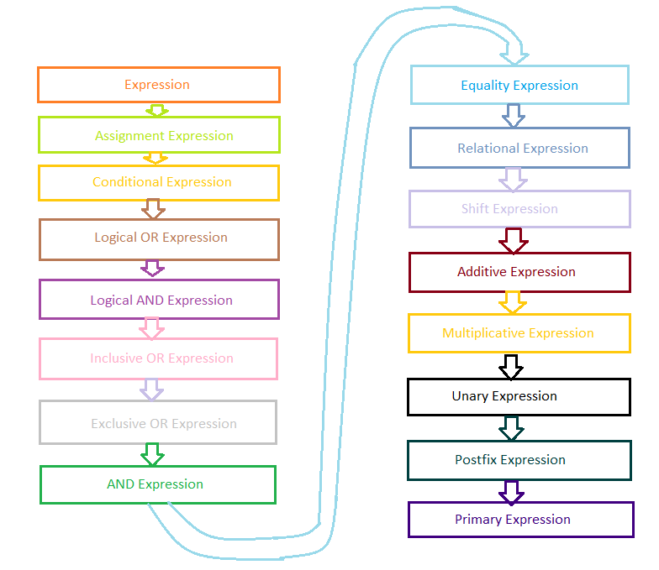
Parsing an expression- Tree flow
This is the tree flow of expression from top to bottom(we can see primary expression is a the bottom)

Slide 21
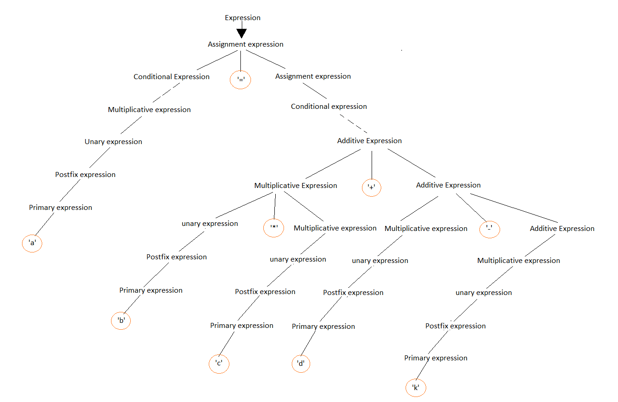
Parsing an expression- dry running
We will take an example and try to run that C expression, the following tree we get below show in picture(yellow highlighted are terminals)
example :- a = b * c + d - k;

Slide 22
Parsing an expression- dry running
Main concept here is the cascading , for example if the first token in an identifier ‘a’ then it will cascade from top(Expression) to the bottom(primary expression) as given the tree flow, if in case i‘+’ operator token occurs then it will cascade down to Additive Expression function where it will match with ‘+’ operator and then continue the loop/recursion till an ‘;’ ids not occurred, now after reading ‘+’ operator token, a new token identifier ‘d’ occurs then it will cascade down from Additive Expression to Primary Expression function for matching the identifier ‘d’

